Slide 1
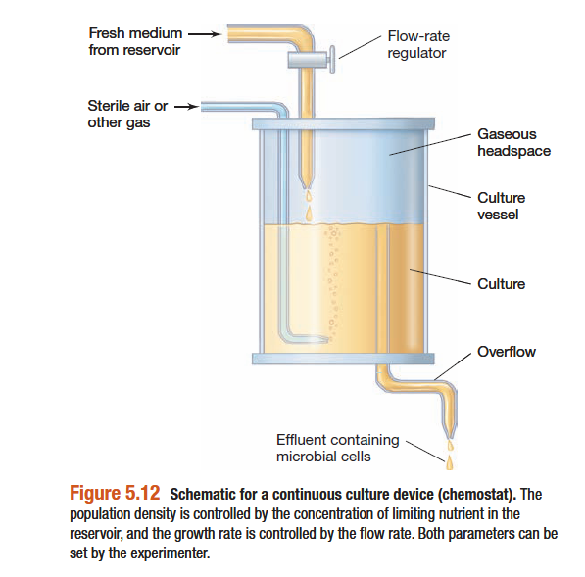
Continuous Culture
Sweta Sushmita Tigga
Lecture-B.Sc Microbiology, Sem-III
Department of Microbiology
DSPMU, Ranchi

Slide 2
Continuous Culture
A continuous culture system is an open system
In the continuous culture growth vessel a known volume of fresh medium is added at a constant rate while an equal volume of spent culture medium (which also contains cells) is removed at the same rate.

Slide 3
Continuous Culture

Slide 4
Continuous Culture
Keep the biomass constant in a bioreactor
Control the concentration of limiting nutrients
The ultimate process is to increase the productivity of process by maintaining the cultures close to its maximum specific growth rate prolonging these maximum production state until the culture is addressed to mutation or the product of loosing its specification

Slide 5
Chemostat

Slide 6
Chemostat
The most common type of continuous culture is the chemostat.
Chemostat, is a device wherein both growth rate (how fast the cells divide) and cell density (how many cells per ml are obtained) can be controlled independently.
Two factors govern growth rate and cell density, respectively:
The dilution rate- The rate at which fresh medium is pumped in and spent medium is removed
The concentration of a limiting nutrients- such as a carbon or nitrogen source, present in the sterile medium entering the chemostat vessel

Slide 7
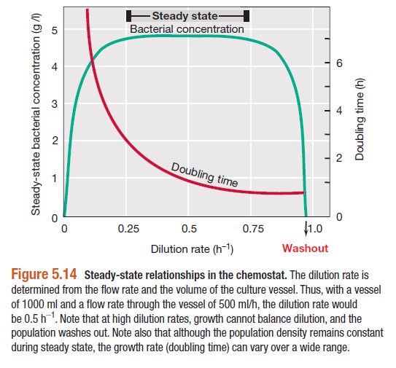
Varying Chemostat Parameters
Two factors i.e dilution rate and concentration of growth-limiting nutrients in a chemostat.

Slide 8
Varying Chemostat Parameters
Steady State break down- wide limits over which the dilution rate controls growth rate, although at both very low and high dilution rate, the organism cannot grow fast enough to keep up with its dilution and is washed out of the chemostat.
At too low dilution rate, cells may die from starvation because the limiting nutrient is not being added fast enough to support minimal cell metabolism

Slide 9
Varying Chemostat Parameters
Cell density in a chemostat is controlled by a limiting nutrient. If the concentration of this nutrient in the incoming medium is increased at a constant dilution, cell density will increase but growth rate will remain the same.
Thus, varying the chemostat dilution rate and nutrient level, one can establish dilute (for ex, 10⁵ cells/ml), moderate (for ex, 10⁷ cells/ml), or dense (for ex, 10⁹ cells/ml) cell populations growing at specific rate.

Slide 10
Chemostat

